Slide 1

Home Language Exams
(Additional qualifications that can be sat at Cardinal Wiseman)
Arabic
Bengali
Chinese (Mandarin)
Chinese (Mandarin/spoken Cantonese)
French
German
Greek
Gujarati
Italian
Japanese
Panjabi
Persian
Polish
Portuguese
Russian
Spanish
Turkish
Urdu
GCSE & A Level
Mrs Kaur – Exams Officer

Slide 2
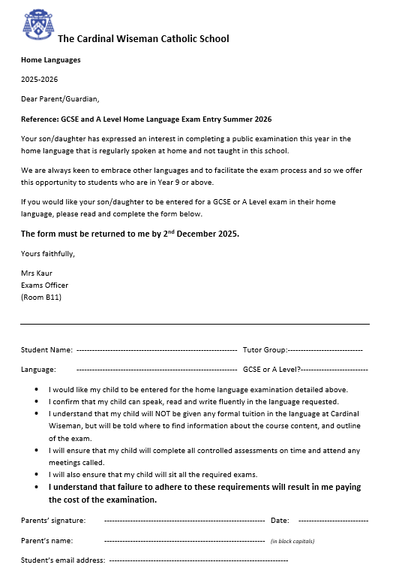
If you speak a different language at home, you have the opportunity to take GCSE and A Level exams in this language at school.

Slide 3
Benefits of sitting GCSE or A Level in home language exams
It is FREE to sit the exam at Cardinal Wiseman
Possibly an excellent exam grade – if you can already speak and write fluently
An extra recognised qualification
Will contribute towards 6th Form or university education entry
Can differentiate you in the job market

Slide 4
What do I need to do now?
If you are in Yr9 or above:
Collect a form from the Exams Officer in B11
Fill the form in, get your parents to sign it and return to the exams office by 2nd December 2025
Commit to preparing yourself for the exams.

Slide 5

THANK YOU
Mrs Kaur – Exams Officer

